Slide 1
Interim Review
Joseph Diggins

Slide 2
What’s done?
Sprint One:
- Manipulated data using Trace Tool
- Created a project in Unity for Digital Twin
- Digital Twin prototype running using data
- Designed first draft of UI in photoshop
1
Sprint Two:
- Met with Liebherr supervisor and obtained more datasets
- Finished design of the UI.
- Integrated UI with Unity
2
Sprint Three:
- Added lift cycles & display in Unity
- Created Azure Functions
- Used Function to store data in Azure database
- Used Azure database to populate Power BI graph.
3

Slide 3
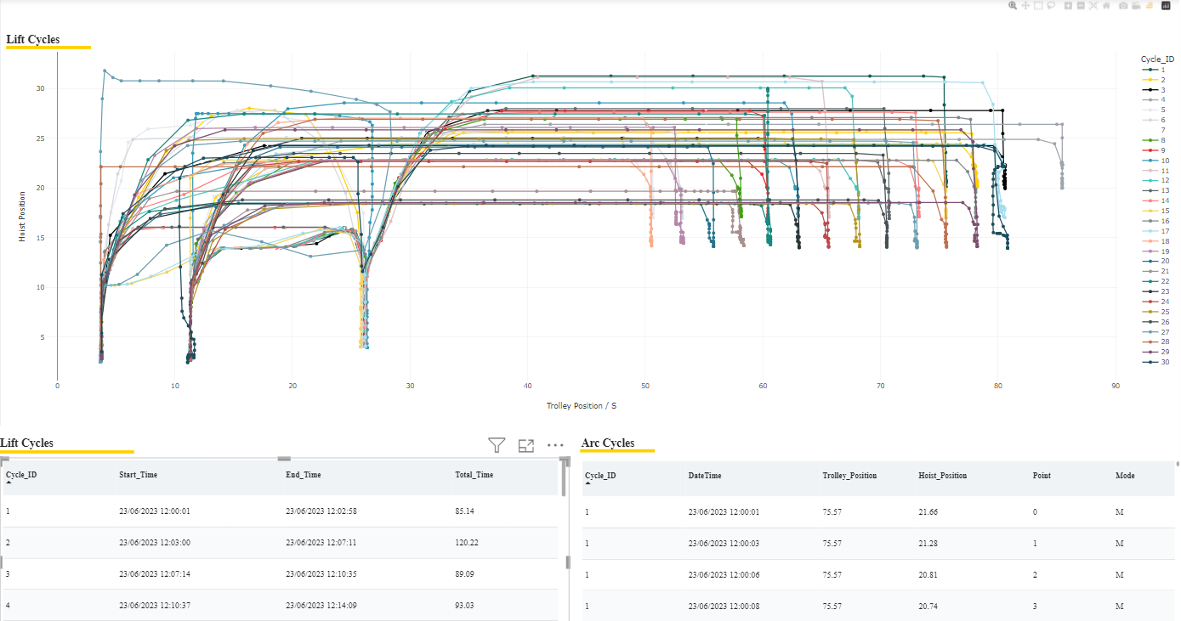
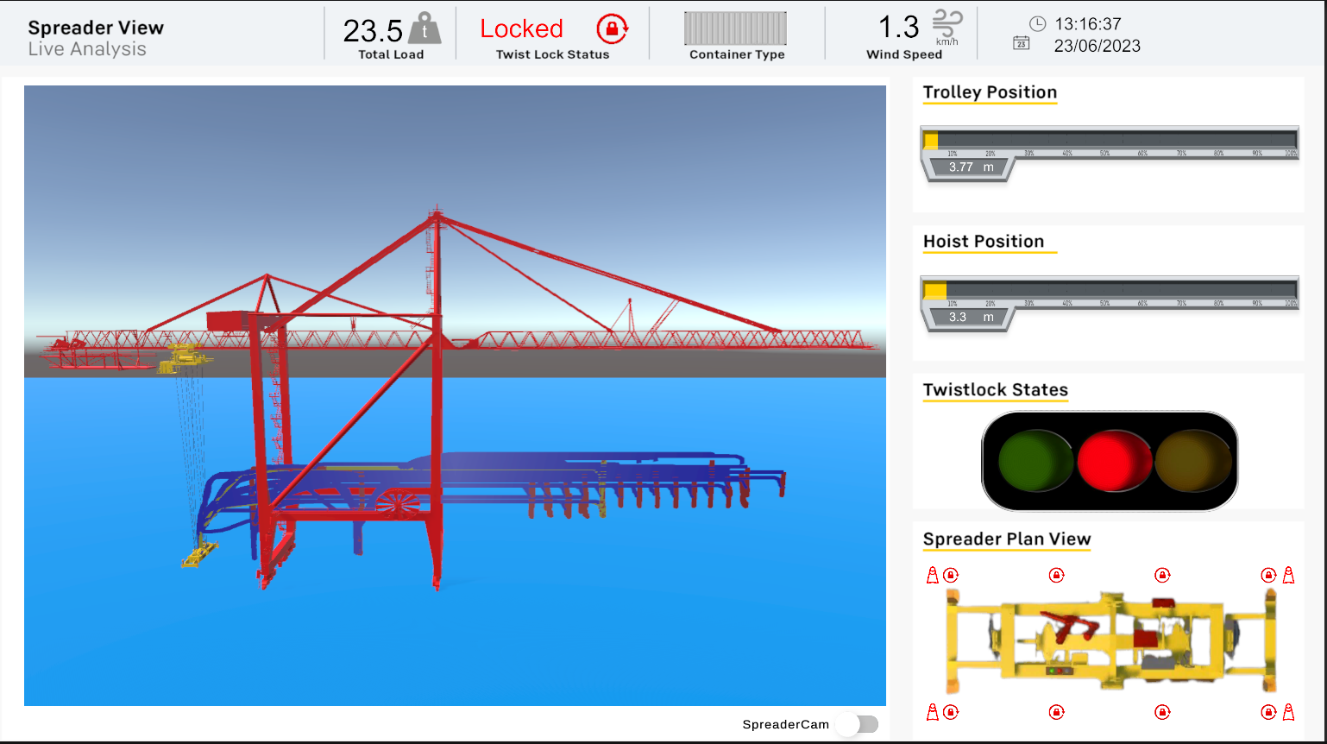

Slide 4
What’s left?
Sprint 4
1
Populate the database with more data
Decide on an algorithm to predict optimal spreader speed
Sprint 5
2
Develop the algorithm.
Sprint 6
3
Integrate algorithm with Digital Twin in Unity
Test the algorithm with the Digital Twin
Sprint 7
4
Explore possibility of real time communication
Ensure no backlog of tasks

Slide 5
Issues
New Software
First time dealing with Power BI & Azure. Made tasks more time consuming than first thought.
Algorithm Complexity
Developing an accurate algorithm may result in complexity making it challenging to fine tune.
Real-Time Integration Challenges
Integrating the algorithm with real-time data in Unity may lead to synchronization issues or performance bottlenecks.
May not be possible
Unity Integration
Using the algorithm on the digital twin may be difficult to integrate.

